Slide 1

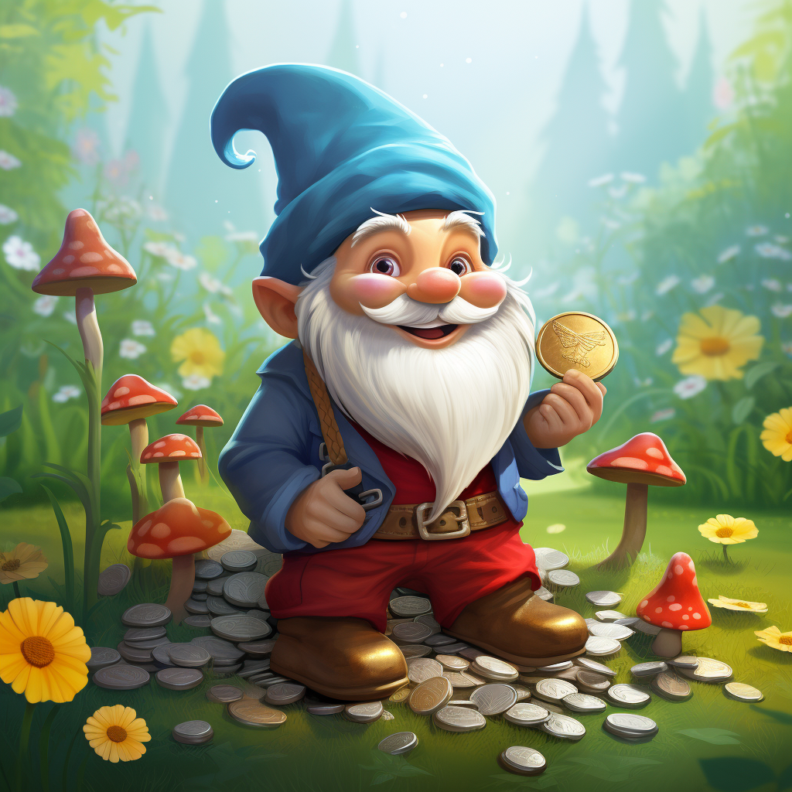
ESA Newsletter
Feb 2025
Who are the ESA and what do they do
The ESA is the Eastcombe School Association, the purpose being to raise funds to enrich the school life of every child attending Eastcombe School.
Every family at Eastcombe primary school forms the ESA and therefore are welcomed to any ESA meeting arranged. As the ESA is a registered charity a committee is formed and this includes Rue Harding-Edgar (Co-Chair) , Charlotte King (Co-Chair) , Nick Wherett (Treasurer) and Fiona Baldwin (Secretary).
Upcoming events
Sponsored Red- 3/03/25
Owl Class cake sale- 1/04/25
Mr King and Mrs Fowles Marathon- 6/4/25
Spin to win- 10/04/25
Gnome Hunt- 17 and18/ 05/25
Squirrel Class cake sale- 19/06/25
New Fundraising Year
The ESA are delighted to say that our fundraising is off to a flying start! We have had some very successful fundraisers since the beginning of term including, Wreath making, Christmas lights, Discos, Cake sales, Spin to Wins alongside other fundraisers. We are delighted that the fundraising pot is being topped up to ensure the children can benefit from the additional opportunities school can offer with the funds raised.
A message from Mrs Jones
Everyone is automatically a member of the Eastcombe School Association and every child benefits from money raised. All school trips are heavily subsidised using ESA funds and many different resources and items are purchased throughout the year. In the last year alone, the ESA has funded a trip to the pantomime, £2000 towards Art and DT resources, the school production, Y6 leavers presents, coach costs for Young Voices and Cotswold Wildlife Park, Bikeability, £700 on class reading books and over £2000 topping up class budgets for stationary, visitors and curriculum resources. Without these additional funds the children would not have the rich extra-curricular experiences that we offer, and the quality of curriculum delivery would be compromised. There are also the social benefits of the ESA events, children and families gather to have fun and share experiences. The Gnome hunt in particular brings the whole school community together sharing a common goal of enjoying the event and raising money for the school. Your support is appreciated and valued.

Slide 2



Sponsored Read
The children are invited to take part again in the ESA sponsored read challenge. More information will be sent home shortly, including a sponsorship form.
The money raised from this will be used to purchase more books from the 100 book scheme running throughout school alongside other reading resources. Last year was the first year we trialled this fundraiser and it raised a staggering £700 which was spent on new books for every classroom, so we would love to see if we can continue the success this year!
Second hand uniform
The ESA has a collection of second hand school uniform in a variety of sizes for sale.
They are also happy to accept donations of second hand uniform in a good condition in which they can sell on, to reduce costs for families buying new uniform but also to recycle wherever possible.
Communication
A reminder that each class has a ESA communication WhatsApp group. This can be used to notify families of the minutes from previous meetings, upcoming events, requesting volunteers and a place to raise any questions regarding the ESA. The funds that have been raised to date and continue to be raised are invaluable to the children’s education and to provide opportunities to enrich their learning. If anyone has any fundraising ideas or can lend a hand at any events please inform the ESA committee.
GOAL
Marathon
As you may have seen from Dojo posts, Mrs Fowles and Mr King are running a marathon around Eastcombe to raise funds for the ESA. Please use the justgiving page link on the Dojo post to show your support.
During the marathon, the ESA plan to be at the school offering some refreshments and craft activities for the children for a small donation, Think banners and foam fingers…Lets motivate the amazing Mrs Fowles and Mr King as they run!! We hope this to be a really lovely feel good family event.

